Slide 1
AI Based Mobile Tracking and Antenna Pointing In Satellite-Terrestrial Network
SHIYAS K
Roll No.59
S7 B-TECH CSE
DEPT. OF CSE, MACE, KOTHAMANGALAM
JANUARY 2021
Approved by : Prof. Neethu Subash
Date: 21/01/2021
25 January 2021
DEPT. OF CSE, MACE, KOTHAMANGALAM

Slide 2
CONTENTS
Artificial Intelligence Based Mobile Tracking and Antenna Pointing in Satellite-Terrestrial Network
Introduction
Objective
Literature survey
Proposed methodology
Result
Conclusion
Future scope
References
25 January 2021
DEPT. OF CSE, MACE, KOTHAMANGALAM

Slide 3
INTRODUCTION
Artificial Intelligence Based Mobile Tracking and Antenna Pointing in Satellite-Terrestrial Network
Satellite terrestrial network communication
The mobile device’s movement trajectory is very complicated
AI-based self learning (ASL) network framework
DL of historical information data of stations and terminals to achieve real-time pointing and tracking
25 January 2021
DEPT. OF CSE, MACE, KOTHAMANGALAM

Slide 4
PROPOSED METHOD
Artificial Intelligence Based Mobile Tracking and Antenna Pointing in Satellite-Terrestrial Network
AI is applied to the design and operation of satellite-terrestrial network
Divided into three steps
Data analysis
Data acquisition
Feedback adjustment
Multi-mode perception information to perceive information about moving targets
Mobile pointing and tracking model are established
Unsupervised learning is used to acquire data from different environments and train, optimize the allocation of resource
DEPT. OF CSE, MACE, KOTHAMANGALAM
25 January 2021
4

Slide 5
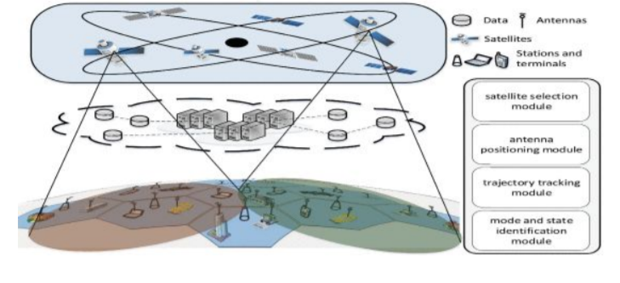
ASL NETWORK FRAMEWORK
Artificial Intelligence Based Mobile Tracking and Antenna Pointing in Satellite-Terrestrial Network
FIGURE 1: ASL network model
Artificial Intelligence Based Mobile Tracking and Antenna Pointing in Satellite-Terrestrial Network - IEEE Journals & Magazine
25 January 2021
DEPT. OF CSE, MACE, KOTHAMANGALAM

Slide 6
ASL NETWORK FRAMEWORK(Cont.)
Artificial Intelligence Based Mobile Tracking and Antenna Pointing in Satellite-Terrestrial Network
Antenna pointing module
Trajectory tracking module
Satellite selection module for the mobile stations and terminals
Mode and state identification module
DEPT. OF CSE, MACE, KOTHAMANGALAM
25 January 2021
6

Slide 7
Artificial Intelligence Based Mobile Tracking and Antenna Pointing in Satellite-Terrestrial Network
POINTING AND TRACKING(Cont.)
Filtering and correct the sensing data
Key frames and local linear embedding
SVM is used to classify and train the key frames
Adjustment of satellite angle
Satellite RS target pointing method
25 January 2021
DEPT. OF CSE, MACE, KOTHAMANGALAM
8

Slide 8
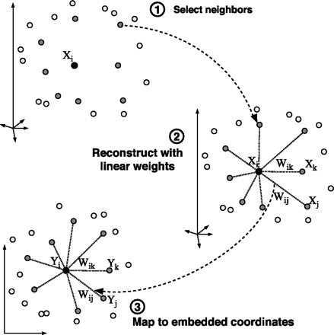
Artificial Intelligence Based Mobile Tracking and Antenna Pointing in Satellite-Terrestrial Network
LOCAL LINEAR EMBEDDING
FIGURE 3: Key frame extraction
https://cs.nyu.edu/~roweis/lle/algorithm.html
25 January 2021
DEPT. OF CSE, MACE, KOTHAMANGALAM
9

Slide 9
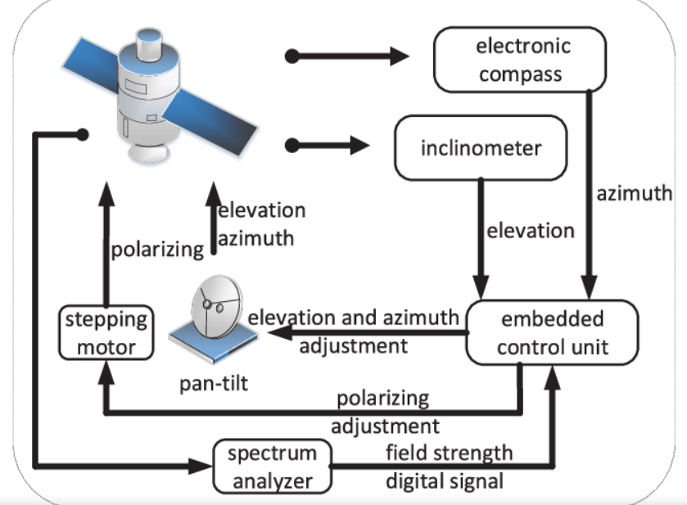
Artificial Intelligence Based Mobile Tracking and Antenna Pointing in Satellite-Terrestrial Network
POINTING AND TRACKING
FIGURE 2: Adjustment of satellite antenna. Motion State Identification and Pointing.
Artificial Intelligence Based Mobile Tracking and Antenna Pointing in Satellite-Terrestrial Network - IEEE Journals & Magazine
25 January 2021
DEPT. OF CSE, MACE, KOTHAMANGALAM

Slide 10
Artificial Intelligence Based Mobile Tracking and Antenna Pointing in Satellite-Terrestrial Network
TRAJECTORY TRACKING AND BEHAVIORAL
INTENTION COGNITION
GPS, compass, and cameras are used to calculate 3D movement data
Motion data are the carrier of behavioural intentions
AI systems used to analyse historical assessment data, summarize digital experience, and judge future trends
Probabilistic network-based reasoning method to reason the behaviour of mobile stations or terminals
25 January 2021
DEPT. OF CSE, MACE, KOTHAMANGALAM
10

Slide 11
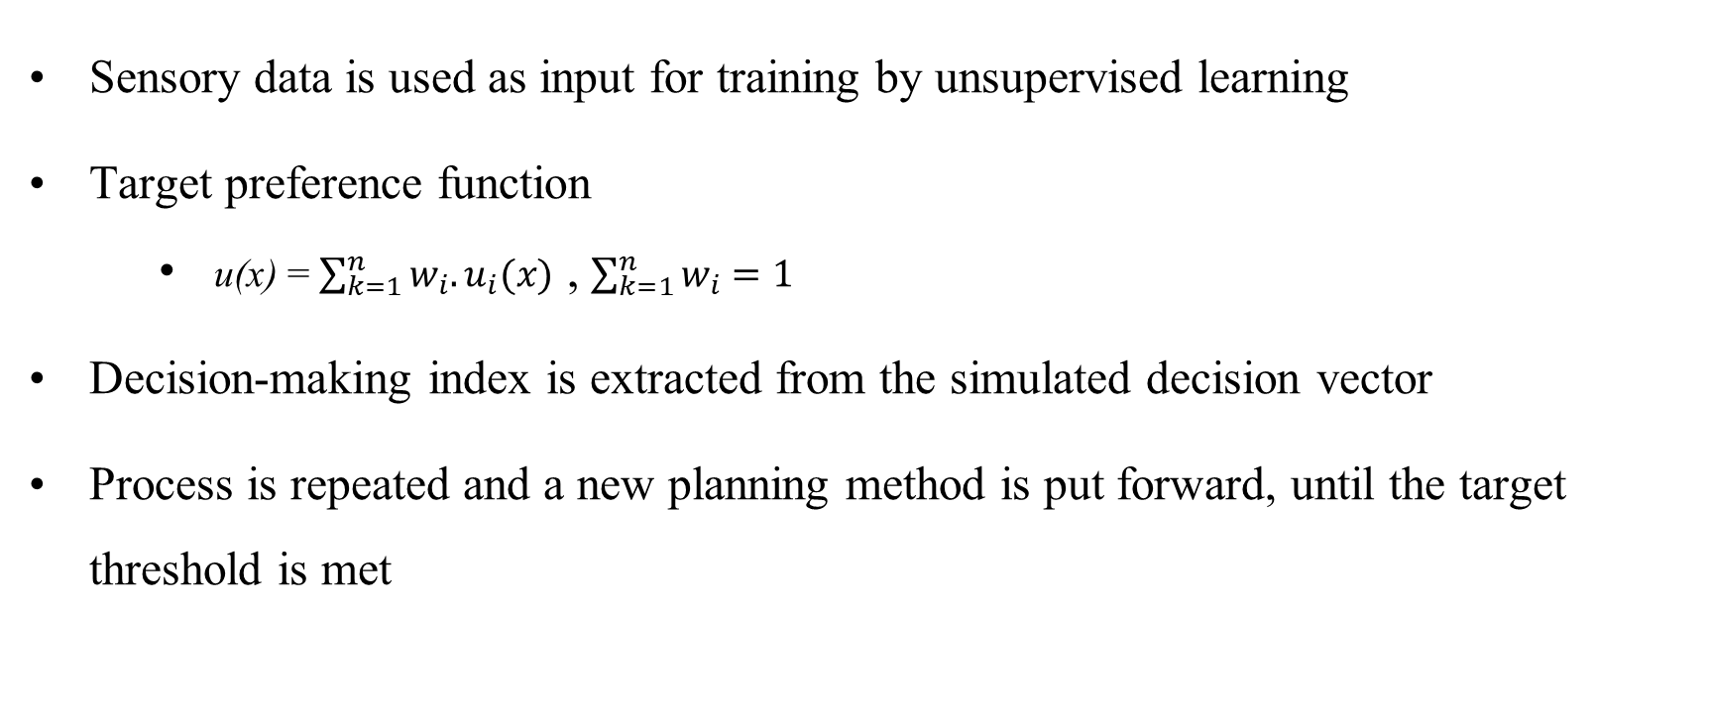
Artificial Intelligence Based Mobile Tracking and Antenna Pointing in Satellite-Terrestrial Network
ANTENNA POINTING AND TRACKING
Sensory data is used as input for training by unsupervised learning
Target preference function
u(x) = $\sum_{k=1}^{n}{w_{i}.u_{i}(x)}$ , $\sum_{k=1}^{n}{w_{i}=1}$
Decision-making index is extracted from the simulated decision vector
Process is repeated and a new planning method is put forward, until the target threshold is met
25 January 2021
DEPT. OF CSE, MACE, KOTHAMANGALAM
11

Slide 12
Artificial Intelligence Based Mobile Tracking and Antenna Pointing in Satellite-Terrestrial Network
SATELLITE SELECTION AND ANTENNA ADJUSTMENT(Cont.)
Antenna azimuth, elevation and polarization of the mobile stations and terminals are regulated by motors
Reinforcement learning method is used to map environmental state to action
Learn optimal strategy for accomplishing the goal by maximizing the cumulative reward value
25 January 2021
DEPT. OF CSE, MACE, KOTHAMANGALAM
13

Slide 13
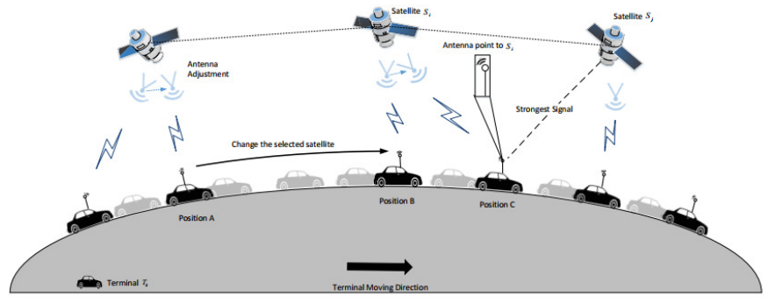
SATELLITE SELECTION AND ANTENNA ADJUSTMENT
Artificial Intelligence Based Mobile Tracking and Antenna Pointing in Satellite-Terrestrial Network
FIGURE 4: Satellite selection
Artificial Intelligence Based Mobile Tracking and Antenna Pointing in Satellite-Terrestrial Network - IEEE Journals & Magazine
25 January 2021
DEPT. OF CSE, MACE, KOTHAMANGALAM

Slide 14
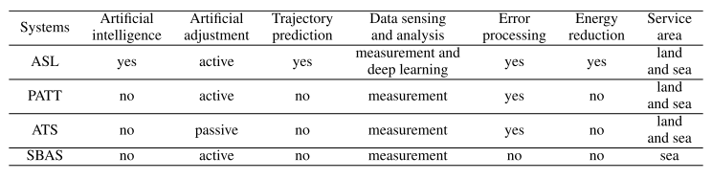
COMPARISON AND ANALYSIS
Artificial Intelligence Based Mobile Tracking and Antenna Pointing in Satellite-Terrestrial Network
TABLE 1: System comparison
Artificial Intelligence Based Mobile Tracking and Antenna Pointing in Satellite-Terrestrial Network - IEEE Journals & Magazine
25 January 2021
DEPT. OF CSE, MACE, KOTHAMANGALAM

Slide 15
CONCLUSION
Artificial Intelligence Based Mobile Tracking and Antenna Pointing in Satellite-Terrestrial Network
The pointing and tracking for stations and terminals in satellite communication realized by using AI
The ASL network framework is proposed for pointing and tracking, and supporting
unsupervised satellite selection and antenna adjustment
Our satellite selection and antenna adjustment for peaking signal is realized by
unsupervised learning
The proposed method is compared with some existing systems to measure their functionality and usability of pointing and tracking
25 January 2021
DEPT. OF CSE, MACE, KOTHAMANGALAM

Slide 16
REFERENCES
Artificial Intelligence Based Mobile Tracking and Antenna Pointing in Satellite-Terrestrial Network
[1] R. B. Dybdal and K. M. Soohoo, ‘‘Narrow beamwidth satellite antenna pointing and tracking,’’ in Proc. IEEE Int. Symp. Antennas Propag., Jul. 2011, pp.
2012–2015.
[2] M. Chen, Y. Hao, H. Gharavi, and V. C. M. Leung, ‘‘Cognitive information
measurements: A new perspective,’’ Inf. Sci., vol. 505, pp. 487–497, Dec. 2019.
[3] C. Aubert, ‘‘Astrium eurostar E3000 antenna tracking system,’’ in Proc.
[4] X. Gan and B. Yu, ‘‘Research on multimodal SBAS technology supporting precision single point positioning,’’ in Proc. Int. Conf. Comput., Commun., Syst., Nov. 2015, pp. 131–135.
25 January 2021
DEPT. OF CSE, MACE, KOTHAMANGALAM

Slide 17
Thank You
25 January 2021
DEPT. OF CSE, MACE, KOTHAMANGALAM

